Slide 1
Iteration statements

Slide 2
Loops
A programmer in C might want to repeat any set of instructions or certain statements in the program to meet the necessary requirements.
We have the following types of loops in C:
Do While Loop
While Loop
For Loop

Slide 3
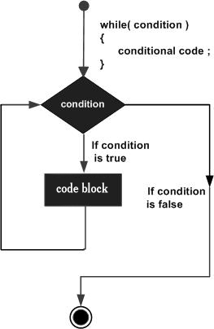
Loops
While loop
#include <stdio.h>
int main ()
{
int a = 10;
while( a < 20 )
{
printf("value of a: %d\n", a);
a++;
}
return 0;
}

Slide 4
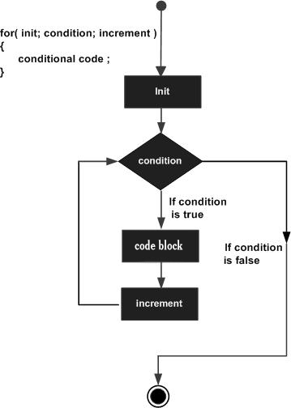
for loop
for ( init; condition; increment ) {
statement(s);
}

Slide 5
for loop Example
#include <stdio.h>
int main ()
{
int a;
for( a = 10; a < 20; a = a + 1 )
{
printf("value of a: %d\n", a);
}
return 0;
}

Slide 6
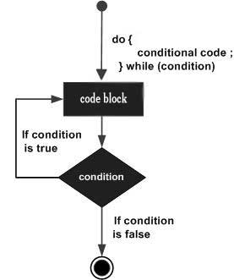
do...while loop
#include <stdio.h>
int main ()
{
int a = 10;
do
{
printf("value of a: %d\n", a);
a = a + 1;
} while( a < 20 );
return 0;
}

Slide 7
Summary of Types of Loops in C:
Type of Loop | Description
for loop | This kind of loop performs the execution of a sequence of various statements various times. It then abbreviates the available code that manages the variables of the loop.
while loop | This type of loop is used for repeating any given statement or a group of various statements whenever the condition we have is true. Thus, it will perform the testing of the condition before the execution of the body of the loop.
do…while loop | This loop is just like the while statement. The only exception is that the do-while statement performs the testing of the condition that is present at the very end of a loop body.
nested loops | We can make use of a single loop or multiple loops inside any other loop, such as for, while, or even the do-while loop.

Slide 8
Loop Control Statements in C
The C programming language provides support for various control statements. These are:
goto statement
continue statement
break statement

Slide 9
Break statement
#include <stdio.h>
int main () {
/* definition of the local variable */
int x = 20;
/* execution of the while loop */
while( x < 40 ) {
printf(“The available value of x is: %d\n”, x);
x++;
if( x > 30) {
/* termination of the loop with the use of the break statement */
break;
}
}
return 0;
}

Slide 10
Continue Statement
#include <stdio.h>
int main () {
/* definition of the local variable */
int x = 10;
/* execution of the do loop */
do {
if( x == 15) {
/* skipping of the iteration */
x = x + 1;
continue;
}
printf(“The given value of a is: %d\n”, x);
x++;
} while( x < 20 );
return 0;
}

Slide 11
Goto Statement
#include <stdio.h>
int main () {
int x = 10;
LOOP:do {
if( x == 15)
{
x = x + 1;
goto LOOP;
}
printf(“The value of the variable x is: %d\n”, x);
x++;
}while( a < 20 );
return 0;
}
Syntax
goto label;
..
.
label: statement;

Slide 12
Summary of Loop Control Statements in C
Type of Loop Control Statements in C | Description
goto statement | This type of statement transfers the control to any labeled statement.
continue statement | This type of statement will cause a loop to skip the remainder present in its body and then retest its actual condition (immediately) before reiterating it.
break statement | This type of statement ultimately terminates the switch statement and the loop statement. It then transfers the statement execution after following the switch or loop immediately.

Slide 13
Nested loop
Nesting of loops is the feature in C that allows the looping of statements inside another loop.
Outer_loop
{
Inner_loop
{
// inner loop statements.
}
// outer loop statements.
}

Slide 14
Nested loop
for (initialization; condition; update)
{
for(initialization; condition; update)
{
// inner loop statements.
}
// outer loop statements.
}
do
{
do
{
// inner loop statements.
}while(condition);
// outer loop statements.
}while(condition);
while(condition)
{
while(condition)
{
// inner loop statements.
}
// outer loop statements.
}

Slide 15
Example – Nested for loop
#include <stdio.h>
int main()
{
int n;
printf("Enter the value of n :");
scanf("%d",&n);
for(int i=1;i<=n;i++)
{
for(int j=1;j<=5;j++)
{
printf("%d\t",(i*j));
}
printf("\n");
}
Enter the value of n :5
1 2 3 4 5
2 4 6 8 10
3 6 9 12 15
4 8 12 16 20
5 10 15 20 25

Slide 16
program uses a nested for loop to print a 2D matrix of 3×// C program that uses nested for loop
#include <stdio.h>
#include <stdlib.h>
#define ROW 3
#define COL 3
int main()
{
int i, j;
int matrix[ROW][COL] = { { 1, 2, 3 },
{ 4, 5, 6 },
{ 7, 8, 9 } };
for (i = 0; i < ROW; i++) {
for (j = 0; j < COL; j++)
printf("%d ", matrix[i][j]);
printf("\n");
}
return 0;
}

Slide 17
Practice Problems
Write a C program to find sum of all even numbers between 1 to n.
Write a C program to calculate sum of digits of a number. 6743
Write a C program to enter a number and print its reverse.
Write a C program to check whether a number is palindrome or not.
Write a C program to calculate factorial of a number.
Write a C program to check whether a number is Prime number or not.
Write a C program to print Fibonacci series up to n terms.
Write a C program to print Pascal triangle upto n rows.
Star pattern programs
Number pattern programs

Slide 18
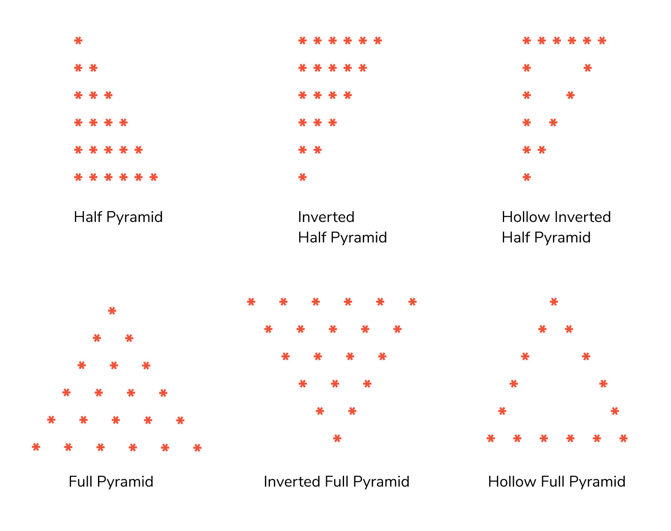
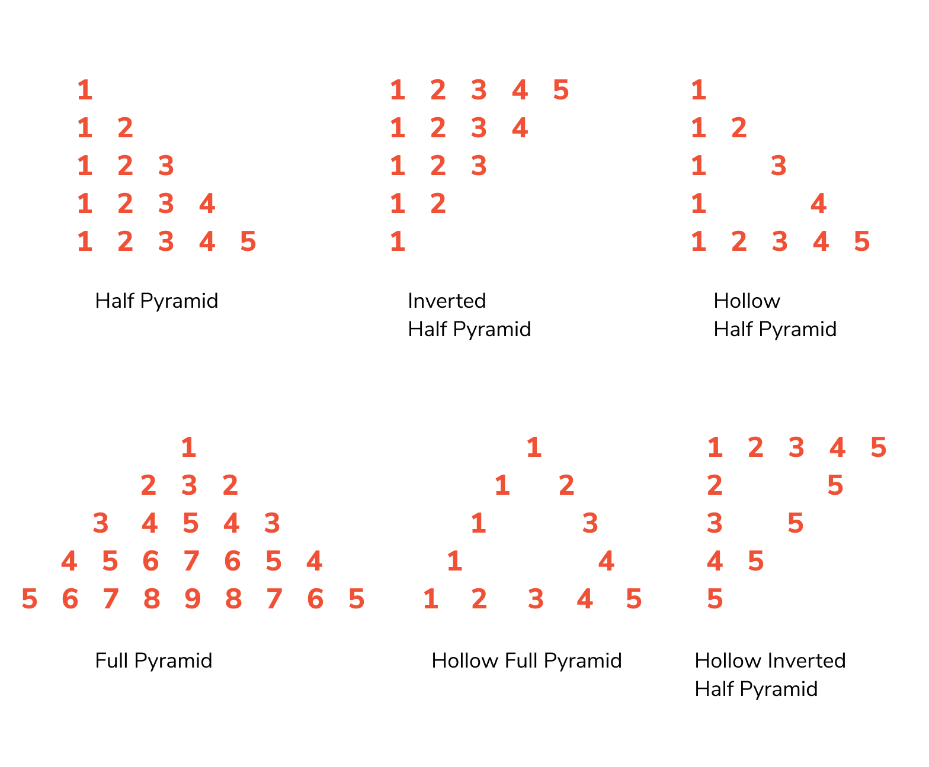

Slide 19
Write a C program to input electricity unit charges and calculate total electricity bill according to the given condition: For first 50 units Rs. 0.50/unit For next 100 units Rs. 0.75/unit For next 100 units Rs. 1.20/unit For unit above 250 Rs. 1.50/unit An additional surcharge of 20% is added to the bill
Write a C program to check whether a number is Prime number or not.
Write a C program to input all sides of a triangle and check whether triangle is valid or not.
Write a program in C to display the n terms of harmonic series and their sum
1 + 1/2 + 1/3 + 1/4 + 1/5 ... 1/n terms
Write a program in C to display the sum of the series [ 9 + 99 + 999 + 9999 ...].
Write a program in C to display the first n terms of Fibonacci series.

